Slide 1

Malak Khaled
IPSEC VPN on Fortigate
IPsec (Internet Protocol Security) is a set of protocols used to make two remote sites ( two LAN networks) communicate as if they are on the same local network over the internet by creating an encrypted tunnel between them.
Why use IPsec?
We use IPsec when we need to:
Connect company branches together (Site-to-Site)
Allow remote users to securely access the corporate network (Remote Access)
Protect sensitive data in transit, such as financial or medical information
Secure traffic traveling over the public Internet
IPsec is suitable for any scenario that requires Security ( Confidentiality of data, Integrity validation, Authentication of both communicating parties )
Page 1

Slide 2
Malak Khaled
IPSEC VPN on Fortigate
IPsec is not a single protocol , it is a suite of protocols :
1) IKE (Internet Key Exchange)
Responsible for authentication, Negotiates encryption and hashing algorithms, Serves as the control channel
2) ESP (Encapsulating Security Payload)
Encrypts data, Ensures data integrity, This is the actual data channel that carries the payload
3) AH (Authentication Header)
Provides integrity only
No encryption >> therefore, FortiGate does not use it
The main focus is IKE + ESP
Page 2

Slide 3

Malak Khaled
IPSEC VPN Phases
Phase 1 is the first step in establishing an IPsec tunnel.
Its goal is to Set up a secure channel between the two devices for negotiation before any actual traffic passes.
Key elements:
Authentication: Verifies the identity of both devices (using a pre-shared key or certificate).
Hash / Integrity: Ensures messages are not altered during exchange ( SHA-256, SHA-1).
Encryption: Protects the key exchange itself so no one can read it.
IKE (v 1 or v 2 ) + Mode (Main or Aggressive (3 message >> initiator , response , authentication identity))
Page 3

Slide 4
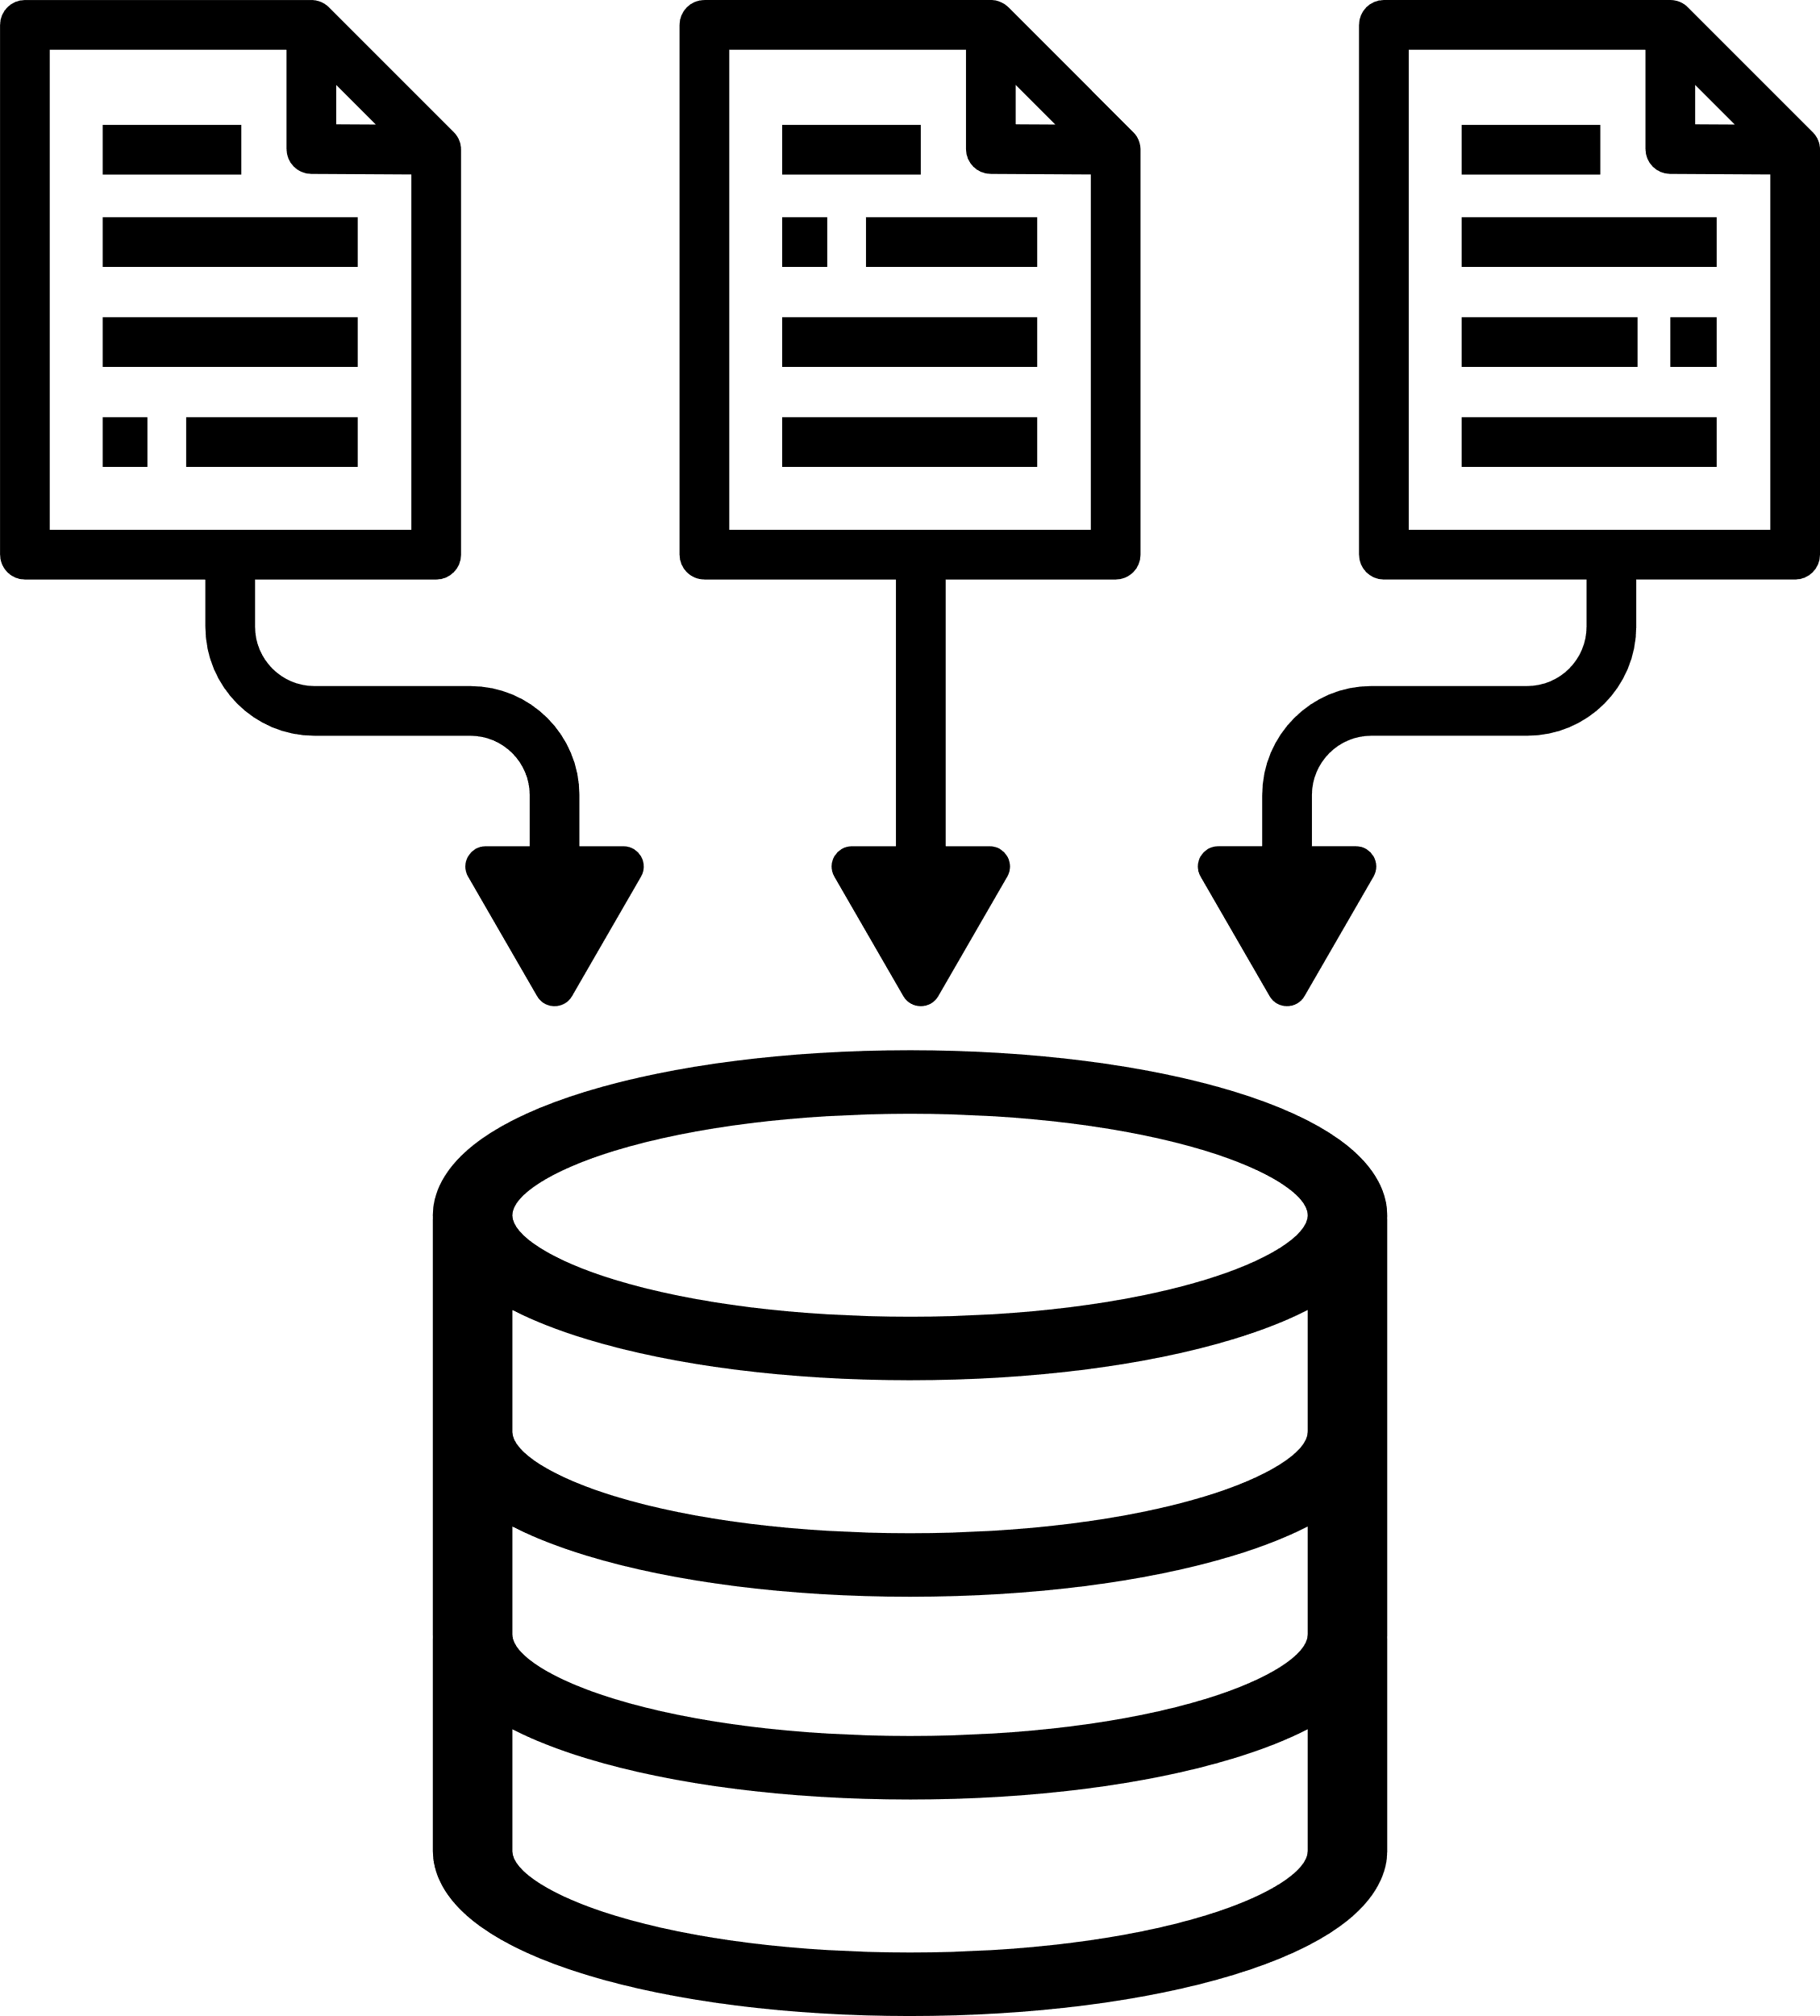
Malak Khaled
IPSEC VPN Phases
Phase 2: Encrypts and protects the actual traffic passes through the tunnel .
Key elements:
Subnets (Traffic Selectors): Defines which networks(Local and Remote) or devices can communicate through the tunnel.
Encryption: Encrypts the actual data packets ( AES-256).
Integrity: Ensures data is not tampered with (HMAC-SHA256).
PFS (Perfect Forward Secrecy): Ensures Phase 2 keys are independent, protecting past data if a key is compromised.
Keepalive is used to prevent the tunnel from going idle, keep it continuously up in routing tables, reduce re-establishment time after small interruptions.
DPD checks whether the remote peer is still alive by sending periodic probes, and if no response is received, it marks the tunnel as down and re-establishes it.
Page 4

Slide 5
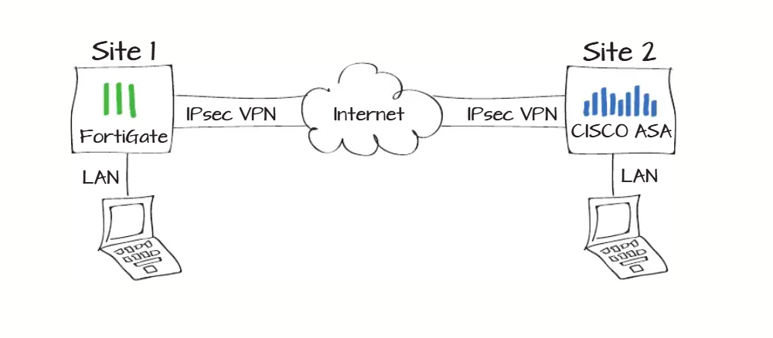
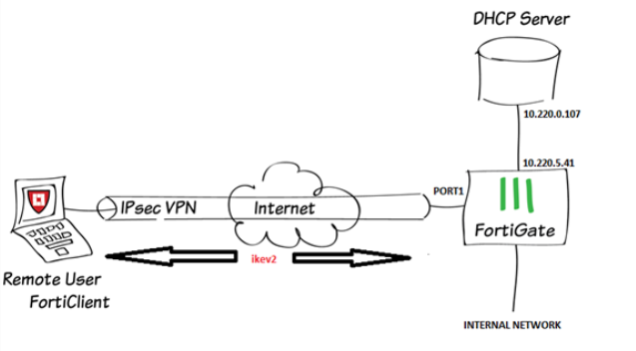
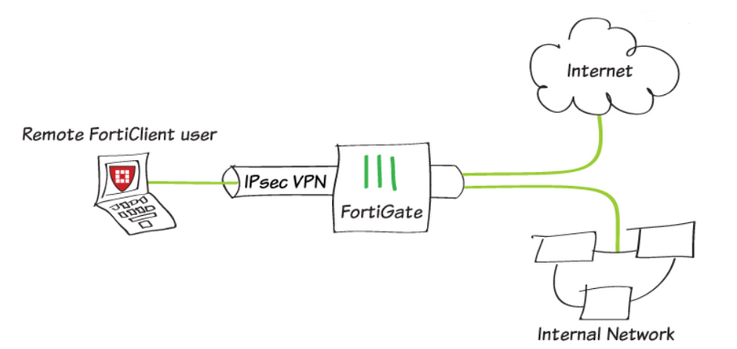
Malak Khaled
IPSEC VPN Types
Page 01
Site-to-Site VPN
Dial-Up / Dynamic VPN
Remote-Access IPsec VPN
Page 5

Slide 6
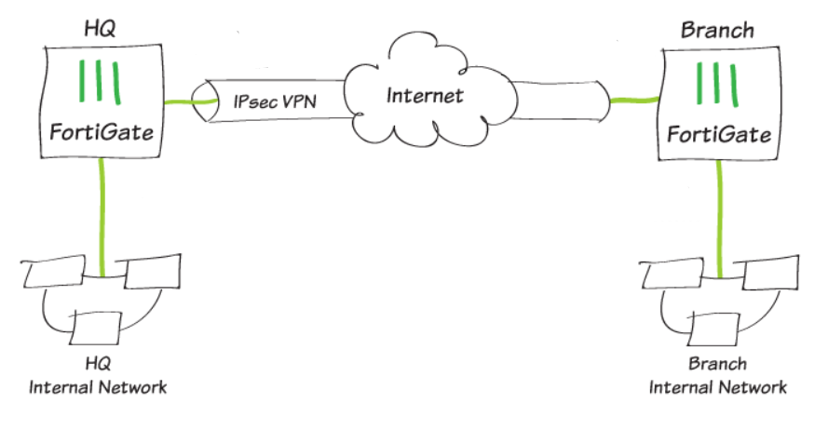
Malak Khaled
IPSEC VPN Project
Site-to-Site VPN
connects two networks through encrypted IPsec tunnels.
Typical Use Case
HQ LAN (192.168.x.x/24) ↔ Branch LAN (172.16.x.x/24)
Both sites use FortiGate ( IPsec-compatible device)
Site-to-Site Configuration Steps (GUI)
https://drive.google.com/file/d/1I4ixABzf3htVaSuYHG5Berz0eJUDAHvB/view?usp=sharing
Page 6

Slide 7
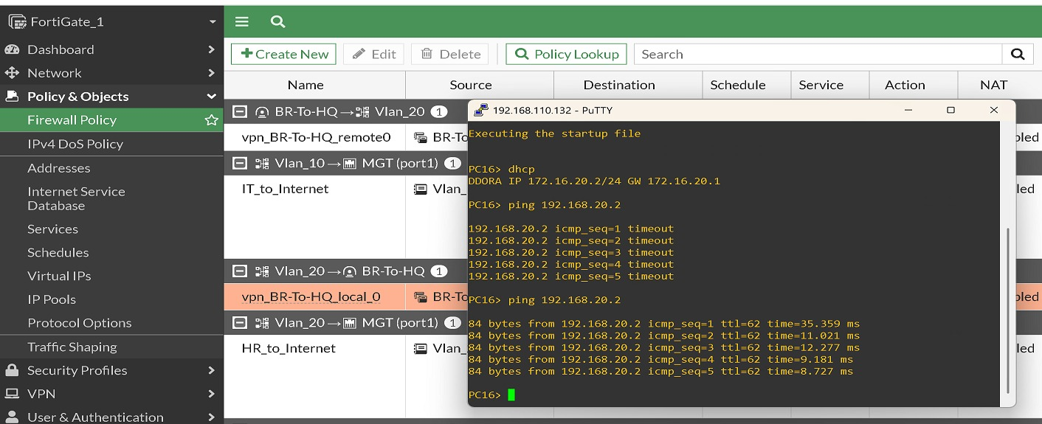
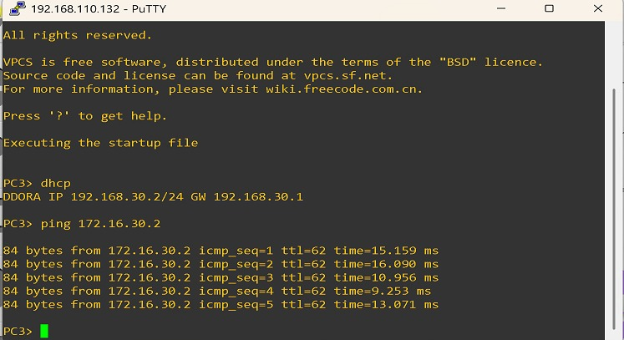
Malak Khaled
IPSEC VPN on Fortigate
After configuring the IPsec tunnel, we test the connection by doing two steps:
First, we send a ping from the local network to the remote network to make sure the traffic is passing through the tunnel.
Page 7

Slide 8
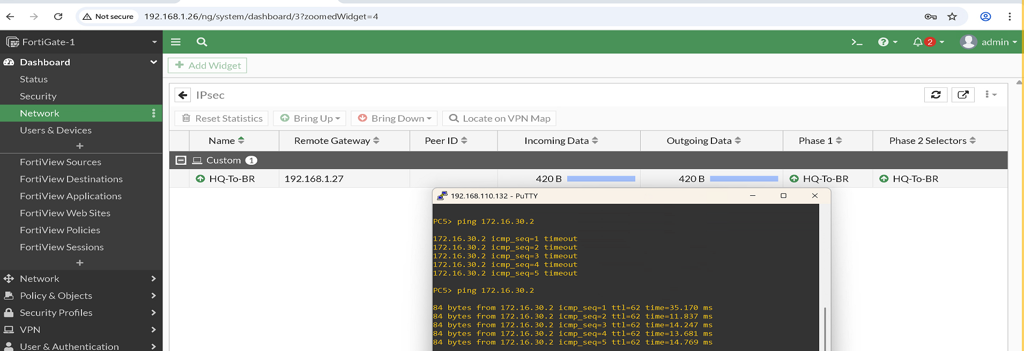
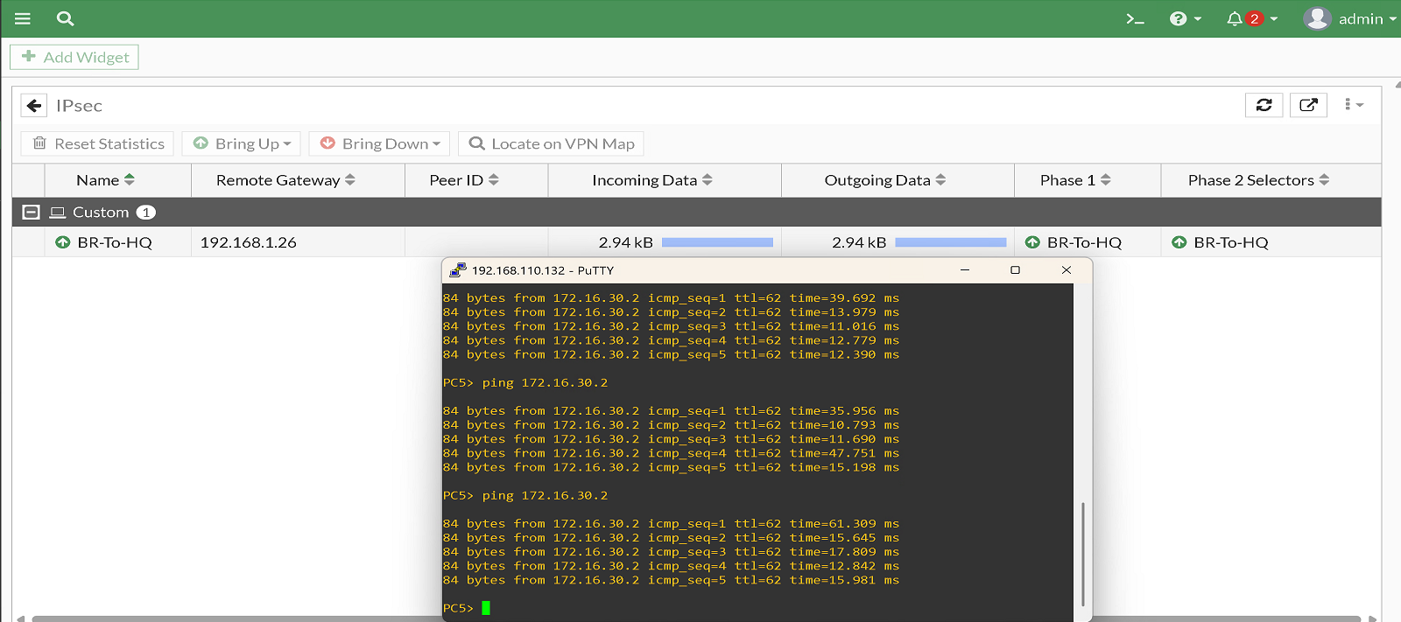
Malak Khaled
IPSEC VPN on Fortigate
2. Then, we check the tunnel status from the FortiGate using the VPN Monitor to confirm that the tunnel is up and encrypted.
Page 8

Slide 9
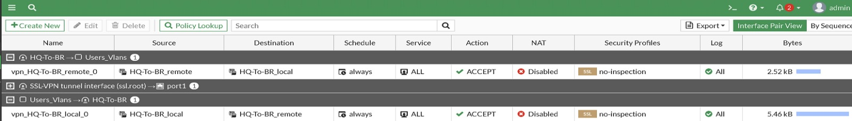
Malak Khaled
IPSEC VPN on Fortigate
Common Troubleshooting
“No matching proposal” >> Phase1/Phase2 mismatch
“Authentication failed” >> wrong PSK or peer ID
No traffic >> missing firewall policy or route
NAT issues >> enable/force NAT-T
1) Check if the IPsec tunnel is Up/Down
diagnose vpn tunnel list
2) Enable VPN debug logs
diagnose debug application ike -1
diagnose debug enable
Page 9

